Slide 1
A Web Development Process
Week 1 Session 2

Slide 2
What is A Web Development Process
A documented outline of the steps needed to be taken from start to finish in order to complete a typical Web design project
It divides and categorizes the work and then breaks these high-level sections into tasks and resources that can be used as a road map for each project.

Slide 3
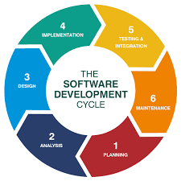
A Typical Process in A Web development
Planning/ Analysis
Defines your goals, objectives, requirements, budget, and resource
Design
Produces a documented site structure and a visual representation
Development/Implementation
Involves the coding and programming work, unit testing
Testing/Launch
Prepare the website for public viewing, integration/ system testing
Post-Launch/ Maintenance
Closing the project, providing instruction and training to your clients

Slide 4
Web Development Process -Planning/ Analysis Phase
Things that you may need to do in this step
Requirement analysis
Gathers client information as much as possible, such as, client goals, target audience, detailed feature requests
Project charter
Summarize the information and agreement
Site map
Provide the structure of a website

Slide 5
Web Development Process -Planning/ Analysis Phase
Contracts
Contains payment terms, project timeline, copyright ownership, roles, etc.
Server Access
FTP host, username and password
Required software & resources
Software, sub contractors

Slide 6
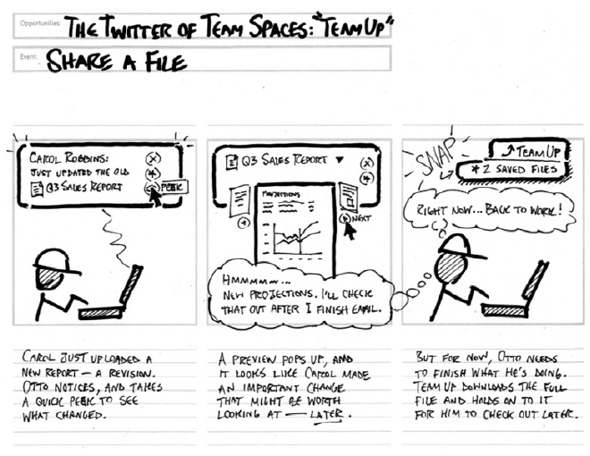
Web Development Process -Design Phase
Things that you may need to do in this step
Storyboards & User flow charts
demonstrate the steps it takes to accomplish tasks

Slide 7
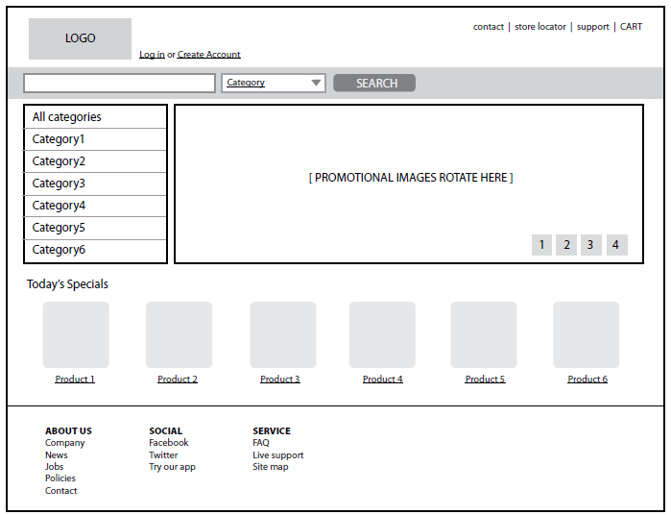
Web Development Process -Design Phase
Wireframe diagrams
Show the structure of a web page

Slide 8
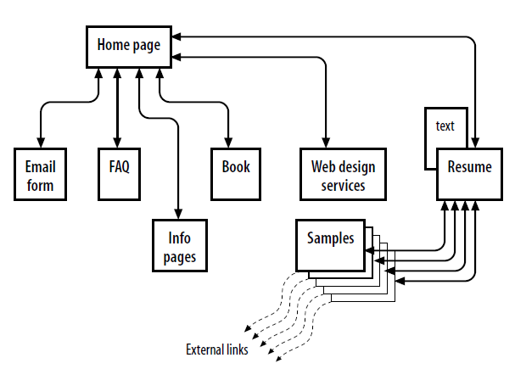
Web Development Process -Design Phase
Site diagram/Site map
The structure of the site as a whole
How individual pages relate to one another

Slide 9

Web Development Process -Design Phase
Mock-ups based on requirements analysis
creates the "look and feel" of the site—logos, graphics, type, colors, layout, etc.
The site makes a good first impression
The site is consistent with the brand of the organization it represents

Slide 10
Web Development Process -Design Phase
Review and Approval cycle
A cycle of reviewing, tweaking and approving the mock-ups
Both client and contractor must satisfied with the design.
This is the easiest time to make changes, not after the design has been coded.

Slide 11
Web Development Process -Development/ Implementation Phase
Things that you need to do in this phase
Authoring/Markup
preparing content for delivery on the Web
marking up the content with HTML tags
Styling with CSS
Scripting and Programming
Frontend – JavaScript, JQuery, Ajax, etc.
Backend – PHP, Ruby, ASP.Net, etc.
Testing and Verify links and functionality

Slide 12
Web Development Process -Testing/Launch Phase
Things that you need to do in this phase
Polishing
Identify parts of website that could be improved in small ways
Transfer to live server
Upload a new website to a live web server
Testing
Run the website through the final diagnostics

Slide 13
Web Development Process -Post Launch/ Maintenance Phase
Things that you need to do in this phase
Hand off to client
Be sure the client is satisfied with the product
All contractual obligations have been met
Provide documentation and source files
Provide documentation for the website
Project close, final documentation
Get the client to sign off on the last checks
Provide your contact information for support
officially close the project.

Slide 14
Exercise
Create A Site Diagram & Wireframe Diagrams

